Slide 1
Federal reserve’s dual mandate
Inflation vs unemployment balance
Mei Qi Ng | FALL 2026 DATA 608: Story 2
Notes:
Story Development Focus:
Highlighting/showcase a message. The slides trace the cause-and-effect chain reaction of the federal policy to prove the mandates are contradictory

Slide 2
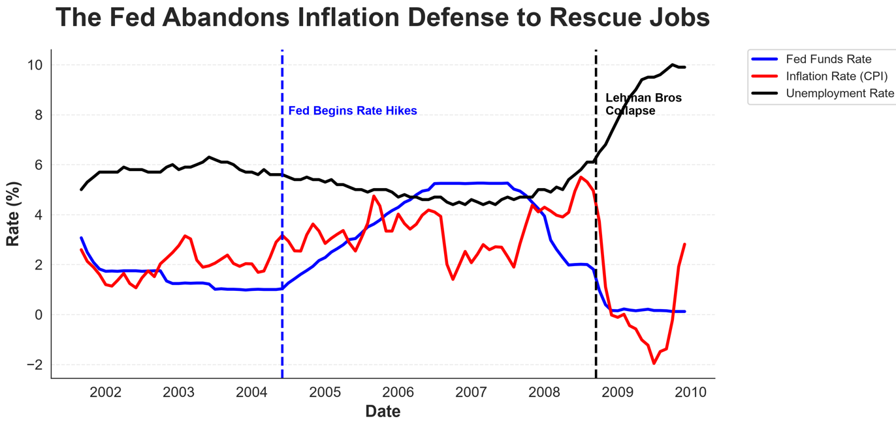
Core Message: Rate hikes increase operating costs with a time lag. The Fed's rate hikes in 2004–2006 triggered a chain reaction, following the 2008 unemployment crash which forced Fed’s to abandon their inflation targets to save jobs
Date Source: Federal Reserve Economic Data (FRED) API; Bureau of Labor Statistics; Federal Reserve Board.
Notes:
A chronological line chart was selected to track the sequence of events over time; to prove rate hikes increase operating costs, which happened before the unemployment spike

Slide 3
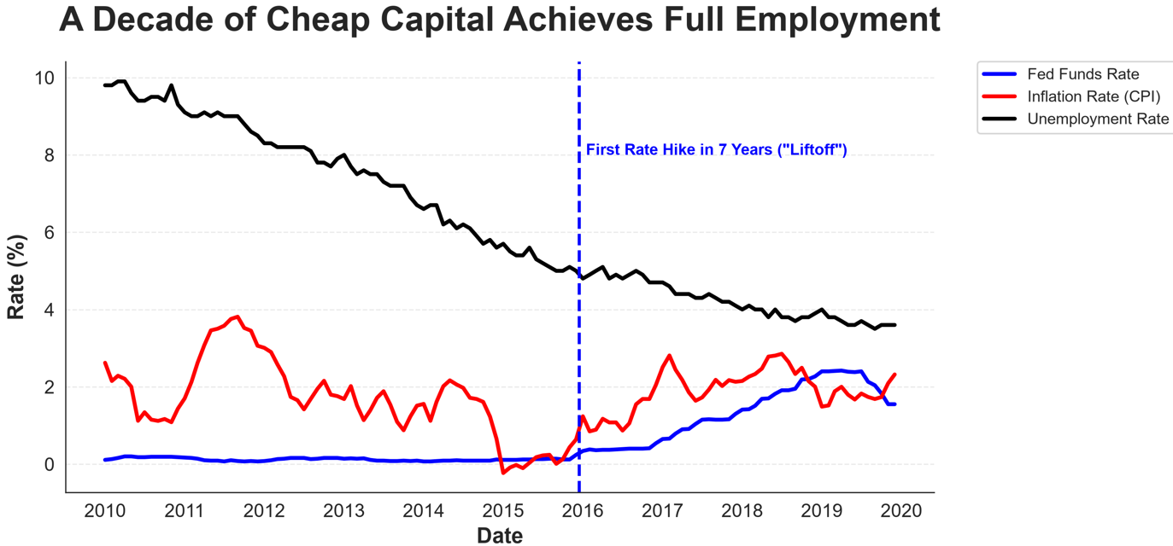
Core Message: Max employment and stable 2% inflation can coexist, but the data shows it required almost a decade of zero-interest-rate policy and an absence of major economic shocks to achieve this balance.
Date Source: Federal Reserve Economic Data (FRED) API; Bureau of Labor Statistics; Federal Reserve Board.
Notes:
A line chart was used to show the prolonged stability of the dual mandate over a 10 year timeline, revealing the exact point (“liftoff hike”) when the Fed felt the labor market had recovered

Slide 4
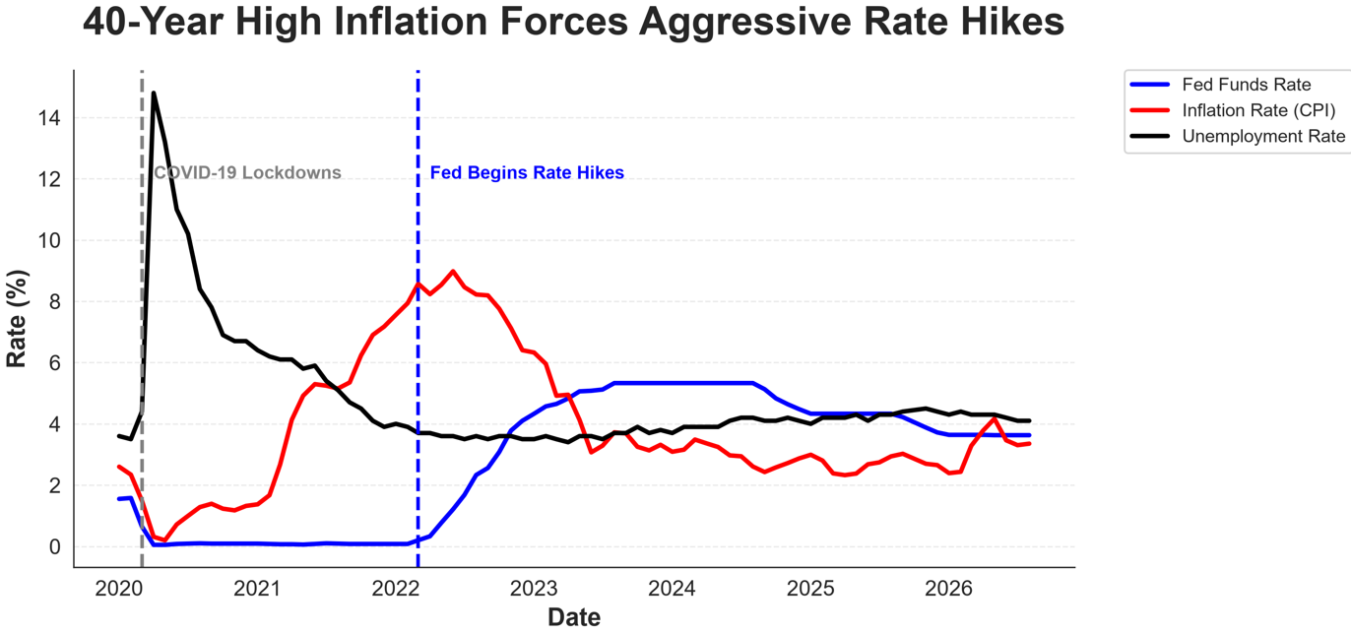
Core Message: The intersection of the line in 2022 proves the contradiction: to crush 40 year long inflation, the Fed was forced to spike borrowing costs which risks higher unemployment
Date Source: Federal Reserve Economic Data (FRED) API; Bureau of Labor Statistics; Federal Reserve Board.
Notes:
A line chart was selected to highlight the drastic visual intersection in 2022 where inflation overtakes rates, forcing an aggressive, delayed policy correction.

Slide 5
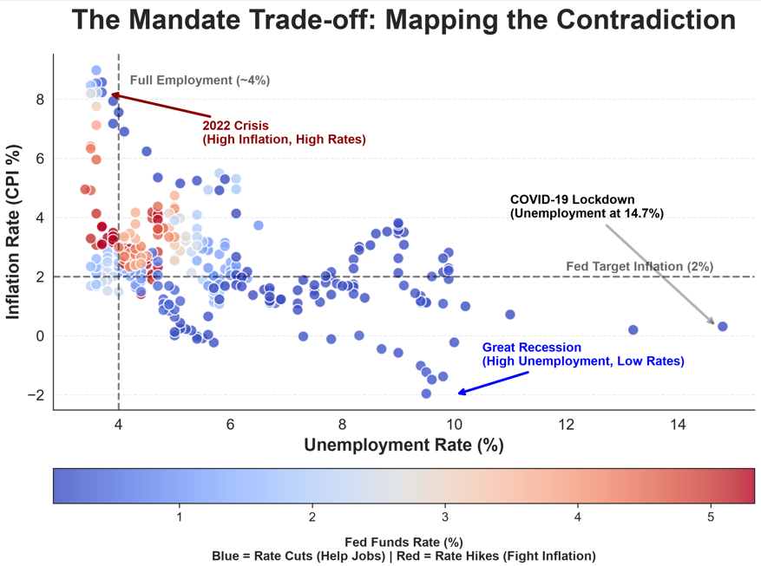
Core Message: Economy never rests in the "Target Bullseye“
Over 25 years, fixing 1 crisis always needed applying interest-rate pressure that disrupts the other side of the mandate
Date Source: Federal Reserve Economic Data (FRED) API; Bureau of Labor Statistics; Federal Reserve Board.
Notes:
A scatter plot was selected to remove the time axis and map the contradiction between inflation and unemployment ( The Phillips Curve). Color encoding replaces the need for a third axis to show Fed's reaction

Slide 6
Fulfill congress mandate? By balancing
1. Are these contradictory objectives?
  YES. The data proves that using the interest rate scale to keep unemployment low (cutting rates), eventually pushes inflation up, and fighting inflation (hiking rates) risks decreasing demand for labor (unemployment up)
2. Has the FED been able to fulfill the mandate?
  YES, but with constant change. Over a 25-year timeline, the Fed acts as a shock absorber: prevent long-term deflation spirals and keep inflation peaks steady by trading off one side of the mandate for the other based on the current economic crisis
Date Source: Federal Reserve Economic Data (FRED) API; Bureau of Labor Statistics; Federal Reserve Board.

